Slide 1
Dishes flow
Ye, Jingyu

Slide 2
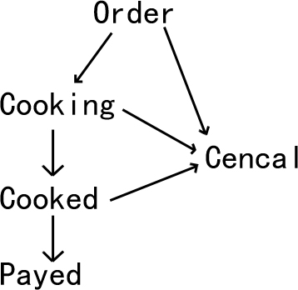
Why is dish flow
Wait staff
Cook
Casher

Slide 3
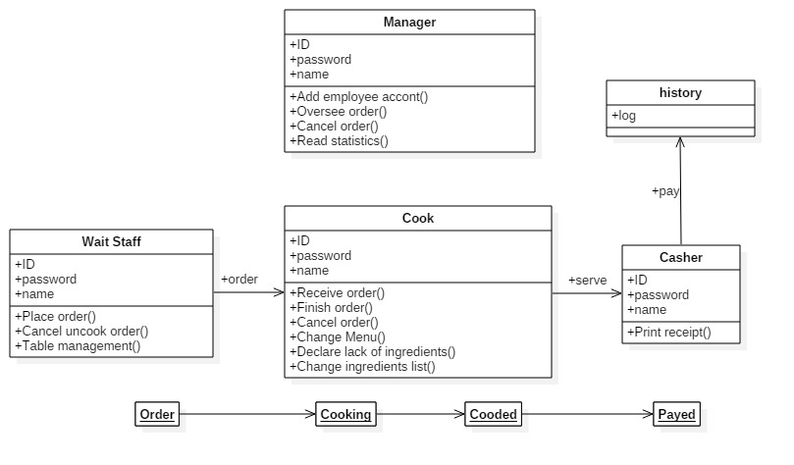
Role

Slide 4
Demo
http://web.cecs.pdx.edu/~jingyu2

Slide 5
Coming Next
login system
Manager page
table management
More clear return massage
JS input check
Improve efficiency

